Slide 1


CSE (H) with specialization in Machine Learning and Artificial Intelligence
Soft Computing (CSF – 332)
Chapter -1.1
Introduction to Soft Computing
By: Dr. Monika Singh E11032
DISCOVER . LEARN . EMPOWER

Slide 2
Course Objectives
To introduce soft computing concepts and techniques of artificial neural networks, fuzzy sets, fuzzy logic and genetic algorithms
To understand the various techniques from the application point of view.
To analyze various soft computing techniques and decide the technique to be used in a particular problem situation.
To implement soft computing based solutions for real-world problems

Slide 3
Course Outcomes
CO1 | Identify and describe soft computing techniques and their roles in building intelligent. Machines | 1
CO2 | Recognize the feasibility of applying a soft computing methodology for a particular problem. | 2,4
CO3 | Apply fuzzy logic and reasoning to handle uncertainty and solve engineering problems, genetic algorithms to combinatorial optimization problems and neural networks to pattern classification and regression problems. | 3
CO4 | Effectively use modern software tools to solve real problems using a soft computing approach. | 3
CO5 | Evaluate various soft computing approaches for a given problem. | 4

Slide 4
Table of Contents
Introduction to soft computing
Difference Between Soft computing and Hard Computing
Major Areas of Soft Computing
Applications of soft computing

Slide 5
Concept of Computation

Slide 6
Properties of Computing
Should provide precise sol.
Control action should be unambiguous and accurate
Suitable for problems that are easy to model mathematically.

Slide 7
Hard Computing
LAZ (Lotfi Aliasker Zadeh) in 1996.
As per him, hard computing gives
Precise results
Steps are unambiguous
Control action is formally defined by a mathematical model/algo.

Slide 8
Examples of Hard Computing
Solving numerical problems such as roots of a polynomial, integration, differentiation etc.
Searching and sorting algorithms give precise results with defined algo.
Shortest tour in a graph.

Slide 9
SOFT COMPUTING (SC)
SC was coined by LAZ.
Lotfi A. Zadeh (Inventor of fuzzy logic) discovered soft computing. He describes it as follows:
“Soft computing is a collection of methodologies that aim to exploit the tolerance of imprecision and uncertainty to achieve tractability, robustness & low solution cost. “
Role model of SC is human brain.

Slide 10
Characteristics of soft computing
It does not require any mathematical modelling of problem solving.
It may not yield precise solution.
Algorithms are adaptive in nature.
Use some biological inspired methodologies such as genetics, evolution etc.

Slide 11
Components of soft computing
•Fuzzy Logic (FL),
•Artificial Neural Networks (ANN),
•Evolutionary Computation (EC),
•Swarm Intelligence (i.e. Ant colony optimization and Particle swarm optimization, )
•Additionally Some Machine Learning (ML) and Probabilistic Reasoning (PR) areas

Slide 12
Examples of Soft Computing
Hand written character recognition

Slide 13
Examples of Soft Computing
Robot movement
Lafta, Hussein. (2013). A Hybrid System Geno-Fuzzified Neural Network for Mobile Robot Control. British Journal of Mathematics & Computer Science. 3. 724-739. 10.9734/BJMCS/2013/4587.

Slide 14
Examples of Soft Computing
How a students learns from a Teacher
Teacher asks question
Hints answers
Telling answers

Slide 15
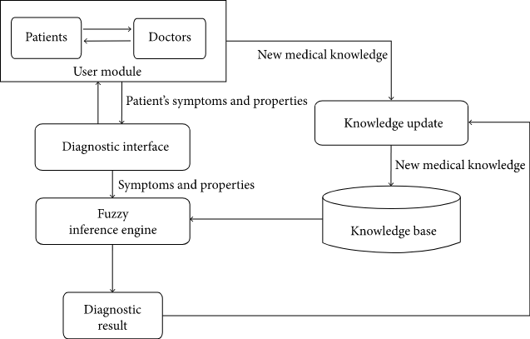
Examples of Soft Computing
How a doctor treats a patient?
Symptoms are correlated with disease with uncertainty
Doctor prescribes medicines/tests with uncertainty

Slide 16
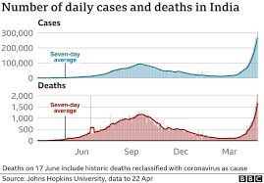
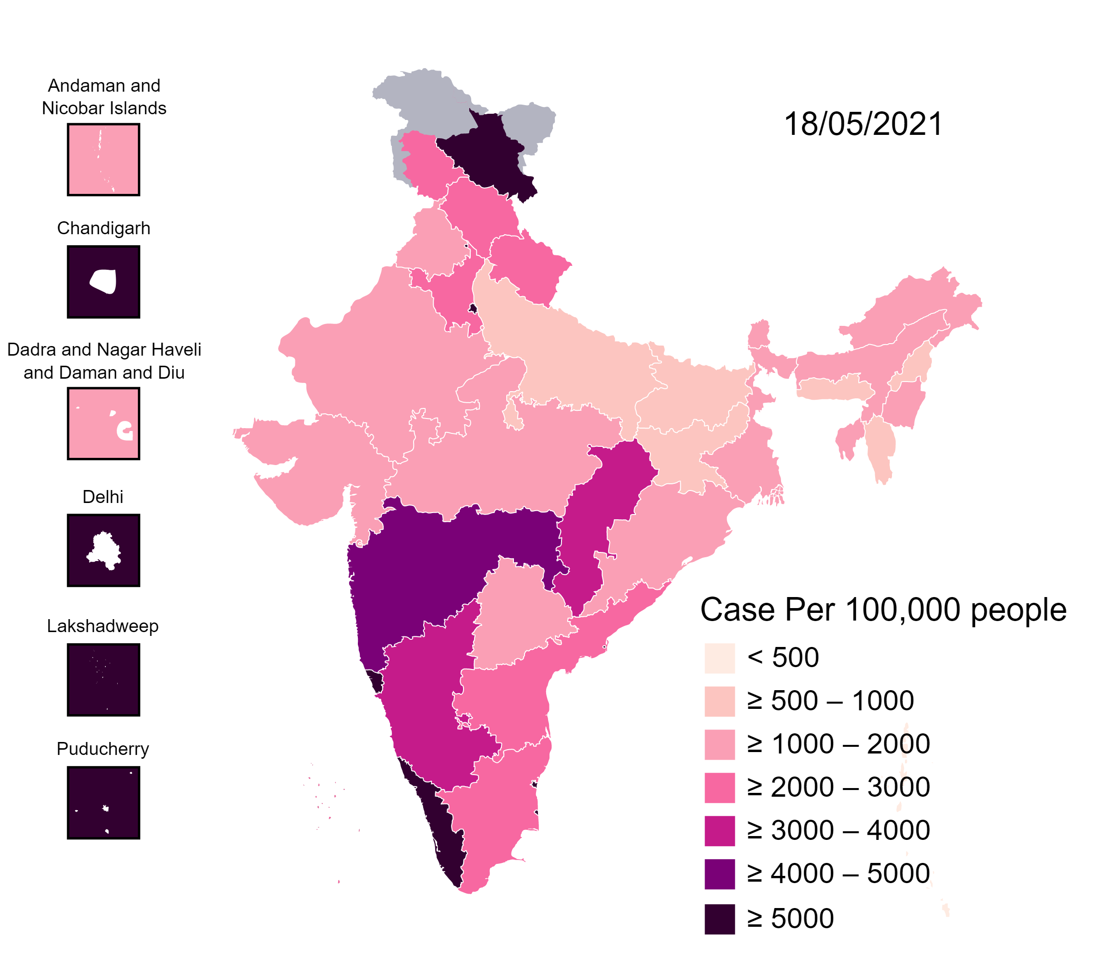
Examples of Soft Computing
COVID 19 Cases in India

Slide 17

Soft Computing
Problem Solving
Decision making
Recognition
Translation
Perception

Slide 18
PROBLEM SOLVING TECHNIQUES
HARD COMPUTING
SOFT COMPUTING
Precise Models
Approximate Models
Traditional Numerical
Modeling and Search
Functional
Approximation
and Randomized
Search
Symbolic
Logic
Reasoning
Approximate
Reasoning

Slide 19

vs Soft computing
Hard computing
Hard Computing | Soft computing
Precisely stated analytical model required | Imprecision is tolerable
More Computation time required | As it involves intelligent computational steps, computational time required is less
It involves binary logic crisp systems and numerical analysis | It involves nature inspired systems such as neural networks, fuzzy logic systems and swarm intelligent system.
Precision is observed within the computation | Approximation is obtained in the computation
Imprecision and uncertainity are undesirable properties | Tolerance for imprecision and uncertainty is exploited to achieve tractability, lower cost, high Machine intelligence quotient and economy of communication.
It produces precise answers | It can produce approximate answers

Slide 20
Hard computing vs Soft computing
Hard Computing | Soft computing
Programs are written which follow standard rules of programming | Programs are evolved which require new laws and theories to be created and justified while programming
The outcome is deterministic(i.e., Every trial run, the output is same) | The outcome is stochastic or random in nature and need not be deterministic
It requires exact input data | It can deal with ambiguous and noisy input data
It strictly follows sequential computations | It allows parallel computations

Slide 21
References
Book:
S.N.Sivanandam, S.N Deepa, “Principles of Soft Computing”
Websites:
https://nptel.ac.in/courses/106/105/106105173/
Videos:
https://www.youtube.com/watch?v=mlfM4SGOAgo
Journal Paper : https://www.sciencedirect.com/science/article/pii/S1877050916325467

Slide 22

THANK YOU
For queries
Email: monika.e11032@cumail.in

Slide 24
OVERVIEW OF TECHNIQUES IN SOFT COMPUTING
➢
Neural Networks
➢
Fuzzy Logic
➢
Genetic Algorithm
➢
Hybrid Systems
“
III CSE A & B

Slide 25
NEURAL NETWORKS
DARPA Neural Network Study (1988, AFCEA International Press, p. 60):
... a neural network is a system composed of many simple processing elements operating in parallel whose function is determined by network structure, connection strengths, and
the processing performed at computing elements or nodes.
According to Haykin (1994), p. 2:
A neural network is a massively parallel distributed processor that has a natural propensity for storing experiential knowledge and making it available for use. It resembles the brain in two respects:
Knowledge is acquired by the network through a learning process.
Interneuron connection strengths known as synaptic weights are used to store weights.

Slide 26
According to Nigrin (1993), p. 11:
A neural network is a circuit composed of a very large number of simple processing elements that are neurally based. Each element operates only on local information.
Furthermore each element operates asynchronously; thus there is no overall system clock.
According to Zurada (1992):
Artificial neural systems, cellular systems which experiential knowledge.
or neural
networks, are physical
can acquire, store and utilize

Slide 27
Advantages of Neural Networks
➢
Adaptive learning- -based on data given for training/ initial experience
Self organization – create own representation of information it receives during training
➢
➢
Real time operation - computation carried in parallel. Special H/W designed and manufactured
➢
Fault tolerance via redundant information coding -
partial destruction leads to corresponding degradation of
performance. Some network capabilities may be retained even after major network damage.

Slide 28
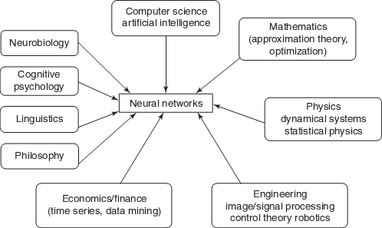
MULTIDISCIPLINARY VIEW OF NEURAL NETWORKS

Slide 29
Conventional Computing vs Neuro Computing
Conventional Computing | Neuro Computing
Computational process is sequential and deterministic | Computational process is not sequential and necessarily deterministic
A single processing unit is present-complex central processor | Many simple processing unit-present. They only takes the weighted sum of their inputs from other processors.
Respond to any programmed instruction | Do not respond to programmed instruction. But respond in parallel such as simulated or actual responses for the pattern of inputs present to it.
Separate addresses for storing data | No separate memory addresses for storing data; however information is contained in the overall activation state of the network
Knowledge is centrally located : if certain parts of data is lost, retrieval in not possible | Knowledge is distributed, data retrieval may be possible if a certain part of data is lost. (similar to the memory retrieval in human brain)
Not suited in situations w^{I}h^{II}e^{C}r^{S}e^{E A}th&e^{B}re are no clear | Well suited to situations where algorithmic solutions are not possible. ¹² Downloaded from: annauniversityedu.blogspot.com

Slide 30
FUZZY LOGIC
➢
Origins: Multivalued Logic for treatment of imprecision and vagueness
1930s: Post, Kleene, and Lukasiewicz attempted to represent undetermined, unknown, and other possible intermediate truth-values.
1937: Max Black suggested the use of a consistency profile to represent vague (ambiguous) concepts.
1965: Zadeh proposed a complete theory of fuzzy sets (and its isomorphic fuzzy logic), to represent and manipulate ill-defined concepts.

Slide 31
FUZZY LOGIC – LINGUISTIC VARIABLES
➢
Fuzzy logic gives us a language (with syntax and local semantics) in which we can translate our qualitative domain knowledge.
➢
Linguistic variables to model dynamic systems
These variables take linguistic values that are characterized by:
➢
•
•
a label - a sentence generated from the syntax
a meaning - a membership function determined by a local semantic procedure

Slide 32
FUZZY LOGIC – REASONING METHODS
➢
The meaning of a linguistic variable may be interpreted as an elastic constraint on its value.
➢
These constraints are propagated by fuzzy inference operations, based on the generalized modus-ponens.
➢
An FL Controller (FLC) applies this reasoning system to a Knowledge Base (KB) containing the problem domain heuristics.
➢
The inference is the result of interpolating among the outputs of all relevant rules.
➢
The outcome is a membership distribution on the output space, which is defuzzified to produce a crisp output.

Slide 33
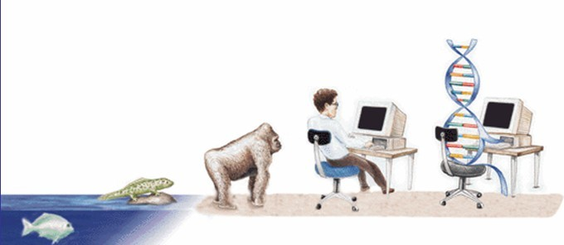
GENETIC ALGORITHM
EVOLUTIONARY PROCESS
Definition of GA : The genetic algorithm is a probabalistic search algorithm that iteratively transforms a set (called a population) of mathematical objects (typically fixed-length binary character strings), each with an associated fitness value, into a new population of offspring objects using the Darwinian principle of natural selection and using operations that are patterned after naturally occurring genetic operations, such as crossover (sexual recombination) and mutation.

Slide 34
HYBRID SYSTEMS
Hybrid systems enables one to combine various computing paradigms and result in a best solution.
soft
The major three hybrid systems are as follows:
➢
Hybrid Fuzzy Logic (FL) Systems
➢
Hybrid Neural Network (NN) Systems
➢
Hybrid Evolutionary Algorithm (EA) Systems
III CSE A & B

Slide 35
Summary
The proliferation of soft computing techniques is remarkable in every field of physics, material sciences, computer chemistry, statistics, etc. This topic outlined various soft computing techniques and different applications areas where these techniques have been applied. The robustness, cost effectiveness, simplicity are the few characteristics of the soft computing. Fuzzy logic is very much suitable for tracking imprecision and uncertainty. Whereas ANN offers good prediction capabilities due to its generalization and learning features. On the other hand, Evolutionary computing techniques have been shown to be very much applicable in optimization problems.

Slide 36
Questions…
What are the differences between Artificial Intelligence and Soft Computing?
How many meta-heuristic methods in soft computing do you know?
How to use readability metrics estimation through soft computing techniques?

Slide 37
References
Book:
S.N.Sivanandam, S.N Deepa, “Principles of Soft Computing”
Websites:
https://nptel.ac.in/courses/106/105/106105173/
Videos:
https://www.youtube.com/watch?v=mlfM4SGOAgo
Journal Paper : https://www.sciencedirect.com/science/article/pii/S1877050916325467

Slide 38
THANK YOU
For queries
Email: monika.e11032@cumail.in

